Slide 1
Blue Table Assignment
PrintNet T

Slide 2

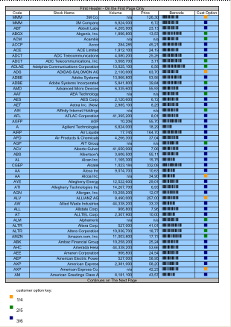
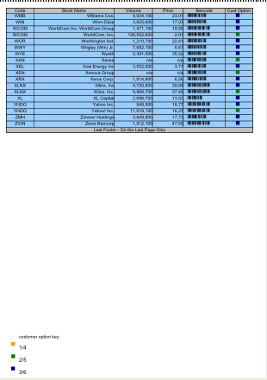
Blue Table Assignment
In this assignment, you will create a job with the following design.
Page 1
Page 17
Notes:
The assignment will be an overflowing table, which overflows to 17 pages of content. The table, as this slide indicates, will need to be formatted. As well, there are barcodes that need to be differentiated by some variable.

Slide 3

Blue Table Assignment
  Open BlueTable_done.pdf.
  Create a .WFD file which duplicates the look and logic of this PDF.
  Use your knowledge of:
      Tables:
        Headers and First Headers
        Repeated Body
        Footers and Last Footers
        Table Properties
      Variable Page selection
      Overflowing
      Barcodes (with variables assigned)
      Elements
      Conditional flow selection
  Only one Layout page is necessary.
  Use BlueTable.wfd – the data structure is created for you.

Slide 4

Thank You.
Do You Have Any Questions?

